Slide 1
Taabish Gazi - 20 CO 20 Arshad Khan - 20 CO 24
Tayyab Sheikh - 20 CO 50

Slide 2



2wwww
TOPIC
“TKINTER””

Slide 3
INTRODUCTION
Tkinter is a standard library in python used for creating Graphical User Interface (GUI) for Desktop Applications. With the help of Tkinter developing desktop applications is not a tough task.
Python offers multiple options for developing GUI (Graphical User Interface). Out of all the GUI methods, Tkinter is the most commonly used method.
It is a standard Python interface to the Tk GUI toolkit shipped with Python. Python with Tkinter is the fastest and easiest way to create the GUI applications.
Creating a GUI using Tkinter is an easy task. In Python, Tkinter is a standard GUI (graphical user interface) package. Tkinter is Python's default GUI module and also the most common way that is used for GUI programming in Python.

Slide 4

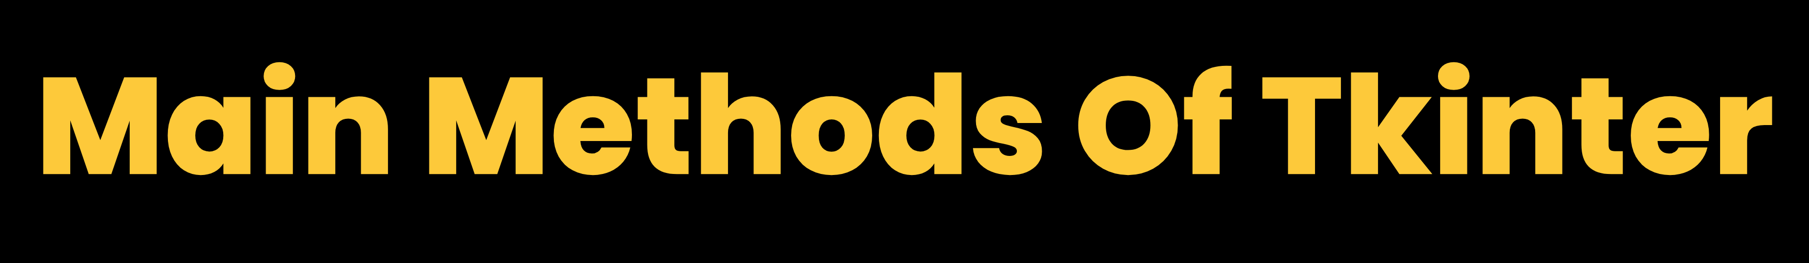
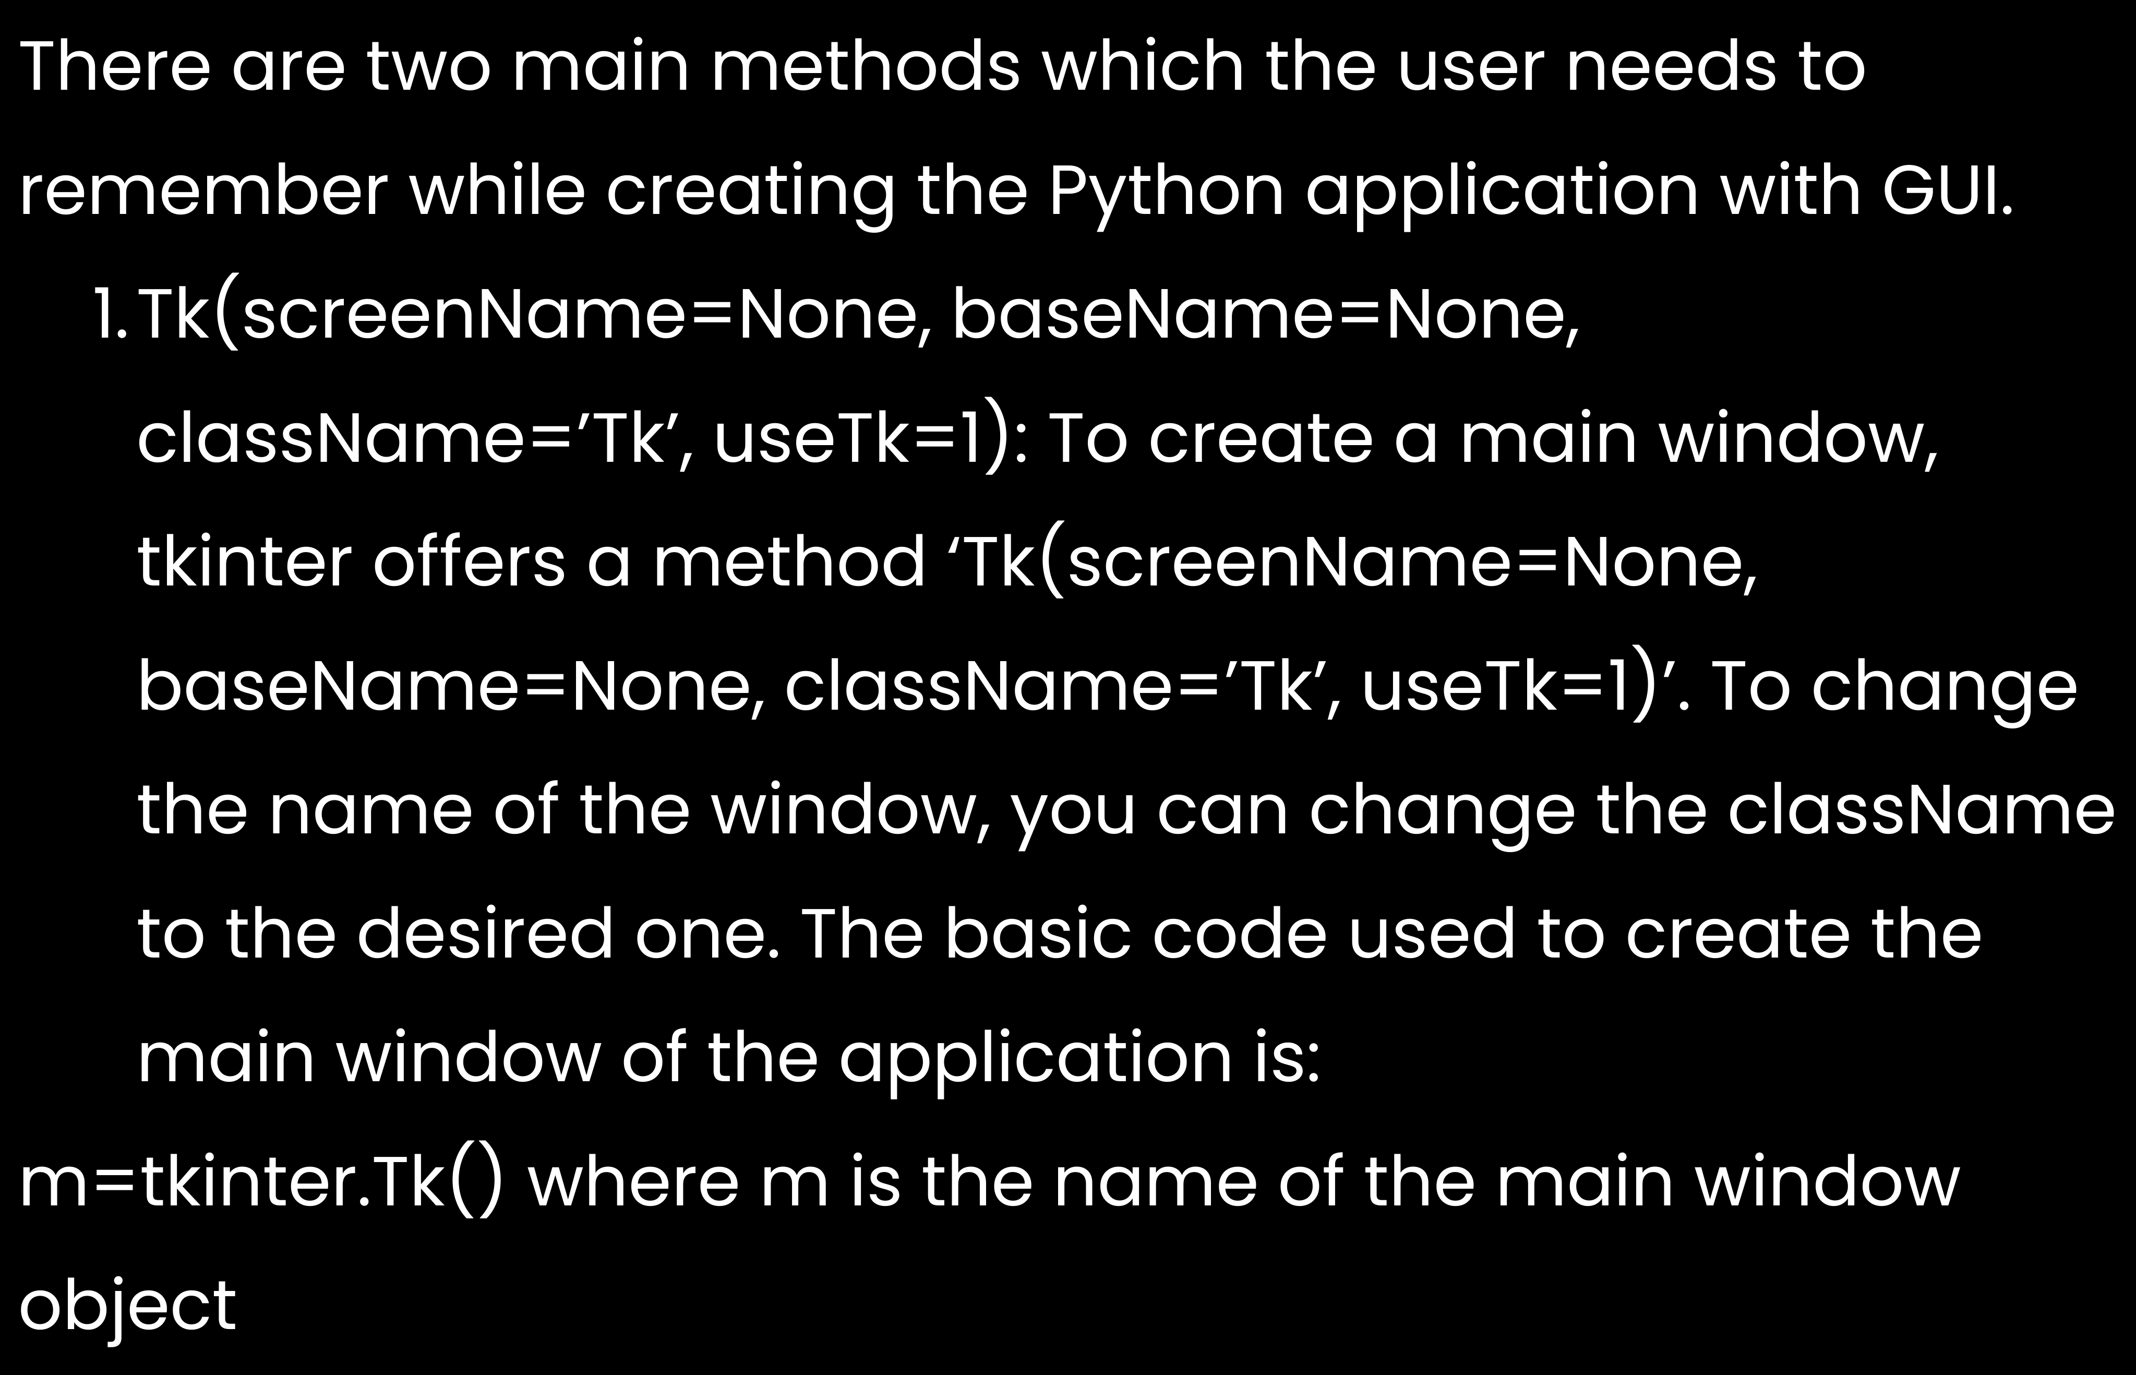

Slide 5

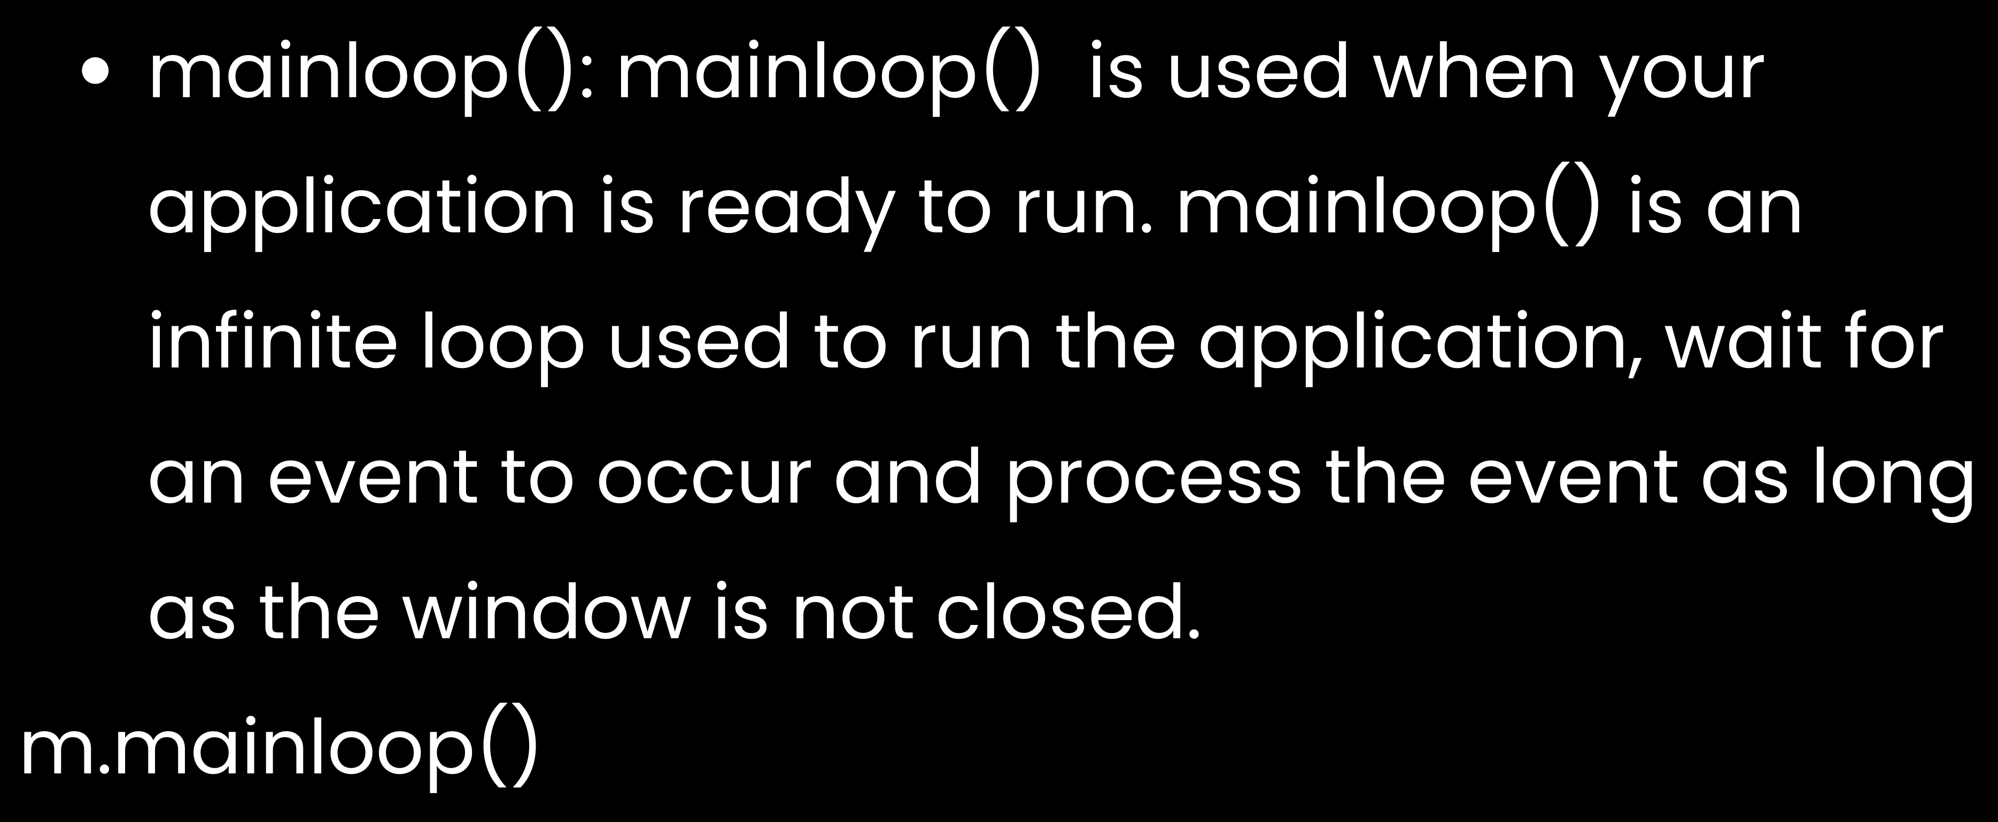

Slide 6











Slide 7


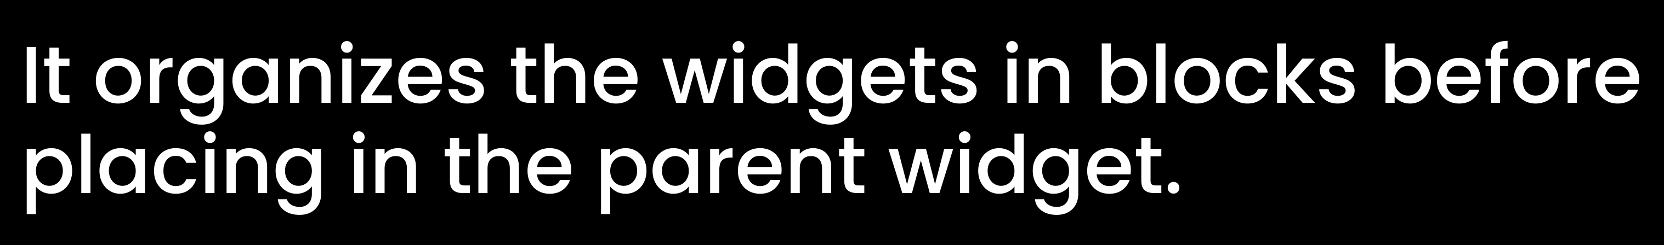


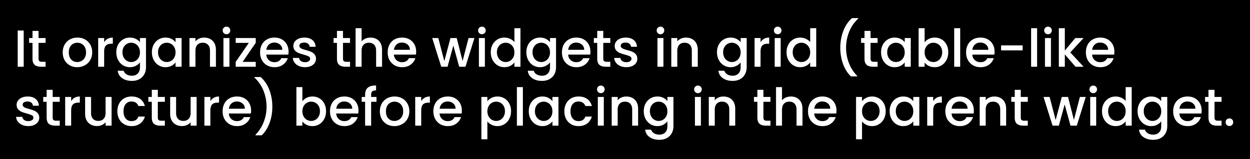

Slide 8


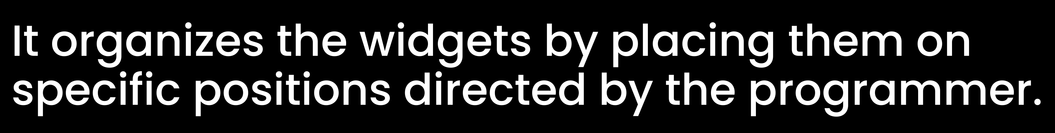

Slide 9

It acts as a container to hold the widgets. It is used for grouping and organizing the widgets. The general syntax is:
w = Frame(master, option=value)
master is the parameter used to represent the parent window.
There are number of options which are used to change the format of the widget. Number of options can be passed as parameters separated by commas. Some of them are listed below.

Slide 10

highlightcolor: To set the color of the focus highlight when widget has to be focused.
bd: to set the border width in pixels. bg: to set the normal background color.
cursor: to set the cursor used. width: to set the width of the widget.
height: to set the height of the widget.

Slide 11


It refers to the display box where you can put any text or image which can be updated any time as per the code.
The general syntax is: w=Label(master, option=value)
master is the parameter used to represent
the parent window.

Slide 12
There are number of options which are used to change the format of the widget. Number of options can be passed as parameters separated by commas. Some of them are listed below.
bg: to set the normal background color. command: to call a function.
font: to set the font on the button label. image: to set the image on the button. width: to set the width of the button. height: to set the height of the button.

Slide 13


It is used to input the single line text entry from the user.. For multi-line text input, Text widget is used.
The general syntax is: w=Entry(master, option=value)
master is the parameter used to represent the
parent window.

Slide 15





Social media moves swiftly in a blink of an eye.
New networks are increasingly emerging, while some others are experiencing demographic changes.
Your business will experience periods of change too.
Your social media strategy needs a living document you can review, and therefore, adjust as required.

Slide 16

We are experts in social media marketing strategy.
Refer to the contact info below for further questions or other inquiries.
Address : 123 Anywhere St., Any City Phone : +123-456-7890
Social Media : @reallygreatsite
Email Address : hello@reallygreatsite.com Website : www.reallygreatsite.com

